Slide 1
REVIEW TECHNIQUES

Slide 2
INTRODUCTION
Software reviews are a filter for the software process. i.e., reviews are applied at various points during software engineering and serve to uncover errors and defects that can then be removed.
Software reviews purify software engineering work products, including requirements and design models, code, and testing data.

Slide 3
INTRODUCTION (CONT.)
A review is a way of using the diversity of a group of people to:
Point out needed improvements in the product of a single person or team.
Confirm those parts of a product in which improvement is either not desired or not needed.
Achieve technical work of more uniform, or at least more predictable, quality than can be achieved without reviews, in order to make technical work more manageable.

Slide 4
COST IMPACTS OF SOFTWARE DEFECTS
Defect implies a quality problem that is discovered after the software has been released to end users.
Error depicts a quality problem that is discovered by software engineers before the software is released.
The primary objective of technical reviews is to find errors during the process so that they do not become defects after release of the software.
The main benefit is the early discovery of errors so that they do not propagate to the next step in the software process.

Slide 5
REVIEW METRICES
Review metrics provide software teams insight of what's happening in the code review process.
It is important for a software engineering organization to understand the effectiveness of each action by defining a set of metrics that can be used to assess their efficacy.

Slide 6
REVIEW METRICES (CONT.)
Preparation effort, Ep :- The effort (in person-hours) required to review a work product prior to the actual review meeting.
Assessment effort, Ea :- The effort (in person-hours) that is expended during the actual review.
Rework effort, Er :- The effort (in person-hours) that is dedicated to the correction of those errors uncovered during the review.

Slide 7
(CONT.)
Work product size, WPS :- A measure of the size of the work product that has been reviewed.
Minor errors found, Errminor :- The number of errors found that can be categorized as minor.
Major errors found, Errmajor :- The number of errors found that can be categorized as major.

Slide 8
ANALYZING METRICES
Before analysis can begin, the total review effort, the total number of errors discover and the error density should be computed.
E_{review} = E_{p} + E_{a} + E_{r}
Err_{tot} = Err_{major} + Err_{minor}
Error density = Err_{tot}÷WPS
This error density of each product can be computed.
Average values for error density enable you to estimate the number of errors to be found

Slide 9
COST-EFFECTIVENESS OF REVIEWS
It is difficult to measure the cost-effectiveness of any technical review in real time. A software engineering organization can assess the effectiveness of reviews and their cost benefit only after reviews have been completed, review metrics have been collected, average data have been computed, and then the downstream quality of the software is measured.

Slide 10
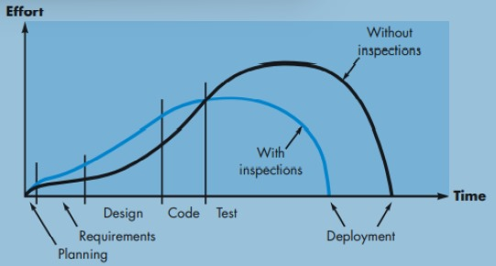
(CONT.)
More importantly, industry data for software reviews has been collected for more than two decades & is summarized qualitatively using the graph illustrated in Figure.
Effort vs Time graph (with and without reviews)

Slide 11
THANK YOU

